Slide 1
제 9장 링크층 개요
최승식

Slide 2
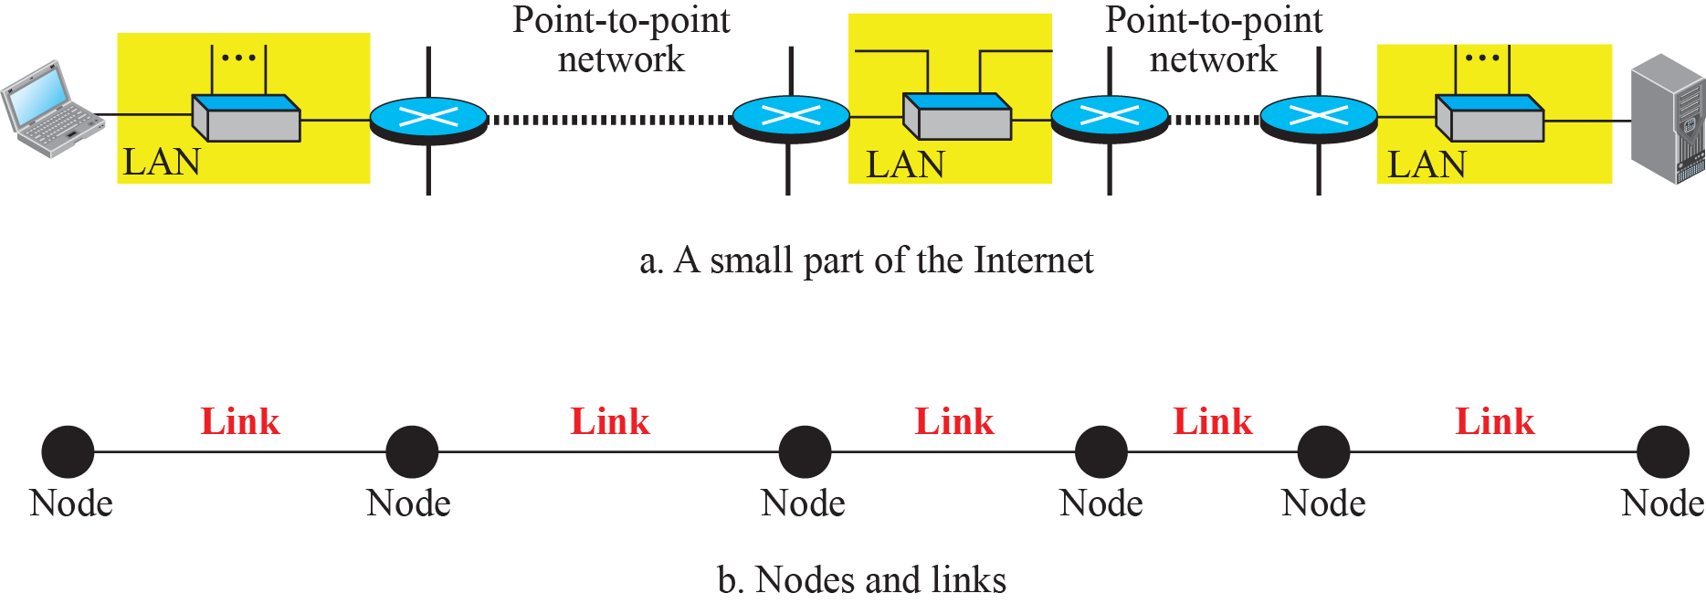
Figure 9.2: Nodes and Links

Slide 3
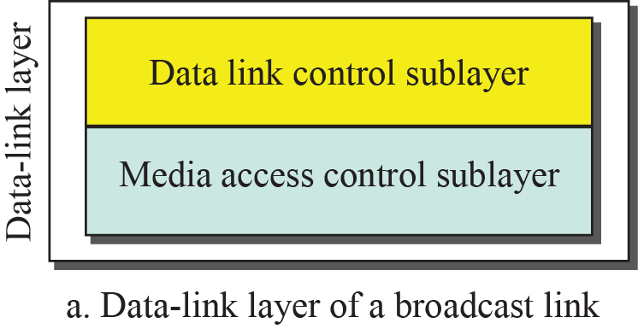
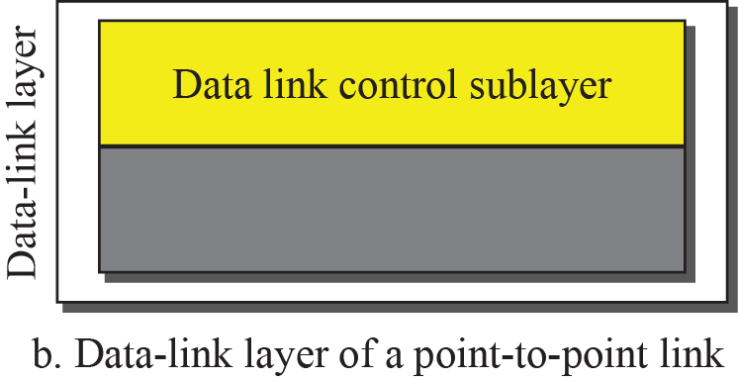
Figure 9.3: Dividing the data-link layer into two sublayers

Slide 4
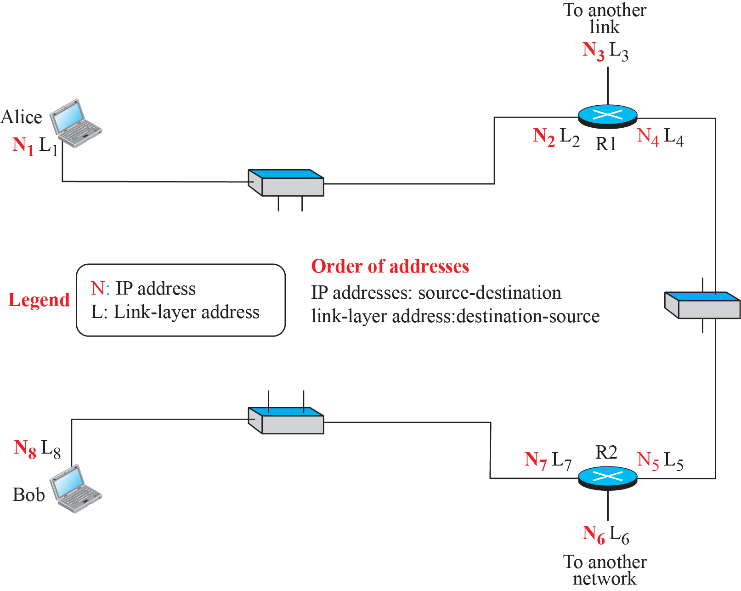
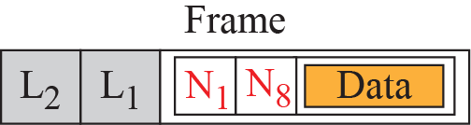
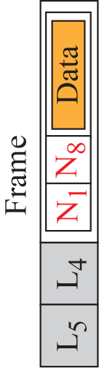
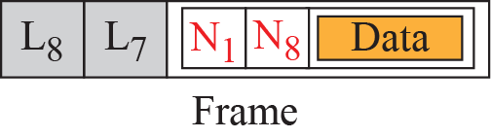
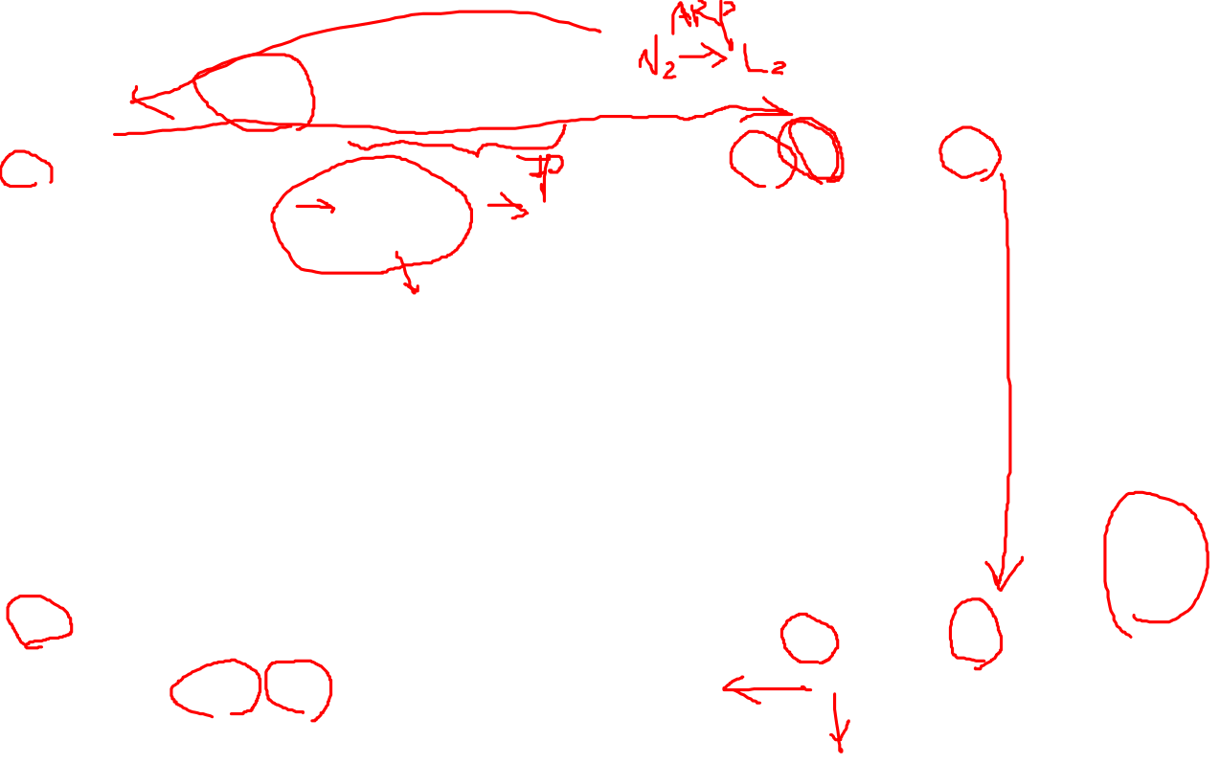
Figure 9.5: IP addresses and link-layer addresses in a small internet

Slide 5
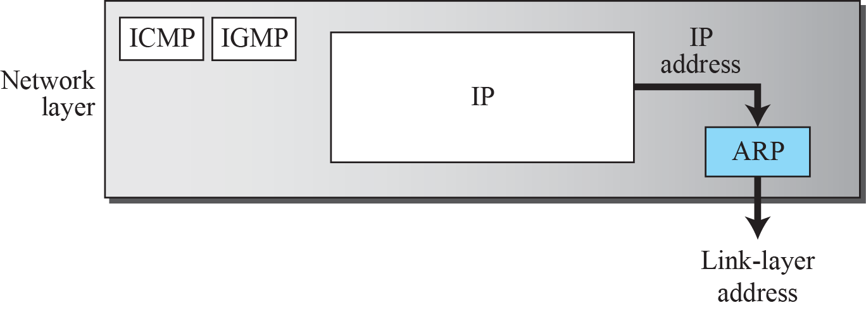
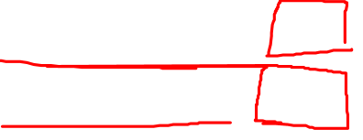
9.2.1 Three Types of addresses
three types of addresses
Unicast
Multicast
Broadcast FF:FF:FF:FF:FF:FF
A3:34:45:11:92:F1
A2:34:45:11:92:F1
Figure 9.6: Position of ARP in TCP/IP protocol suite

Slide 6
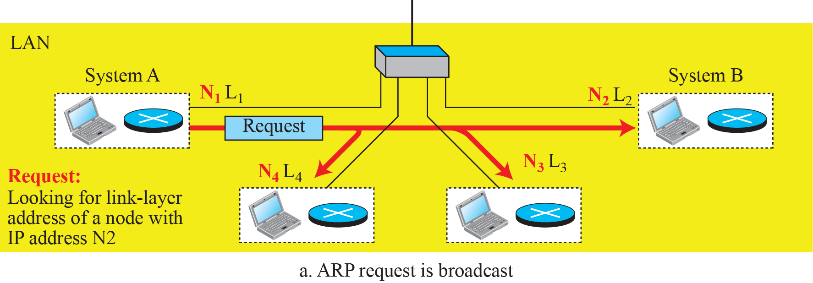
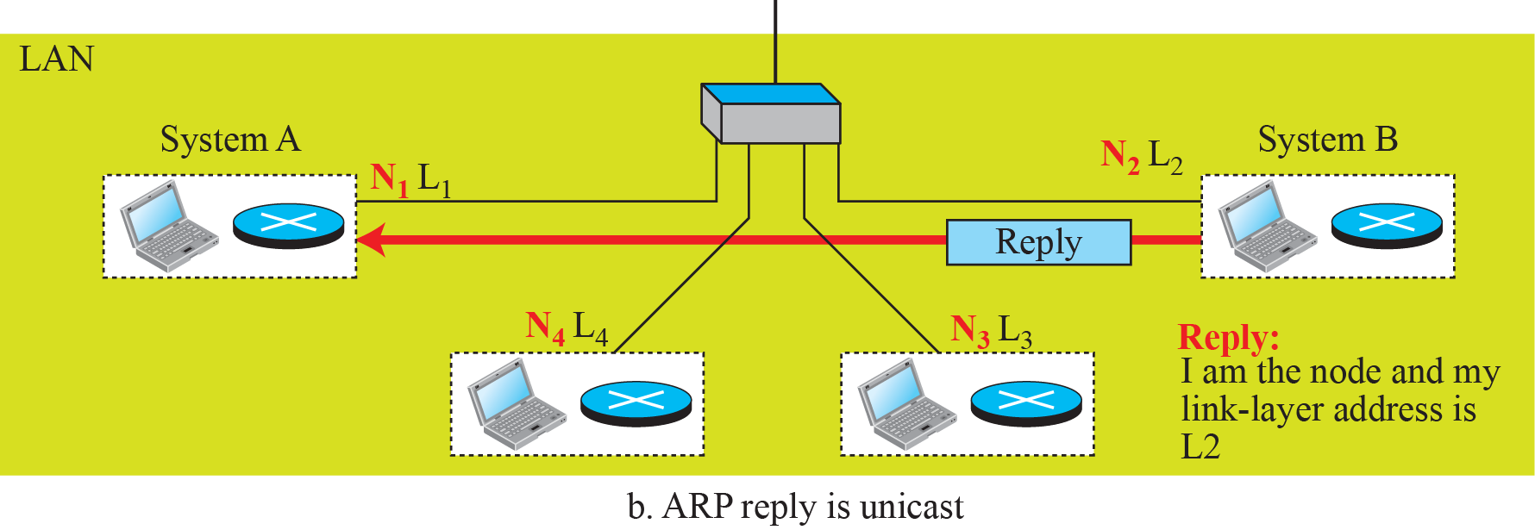
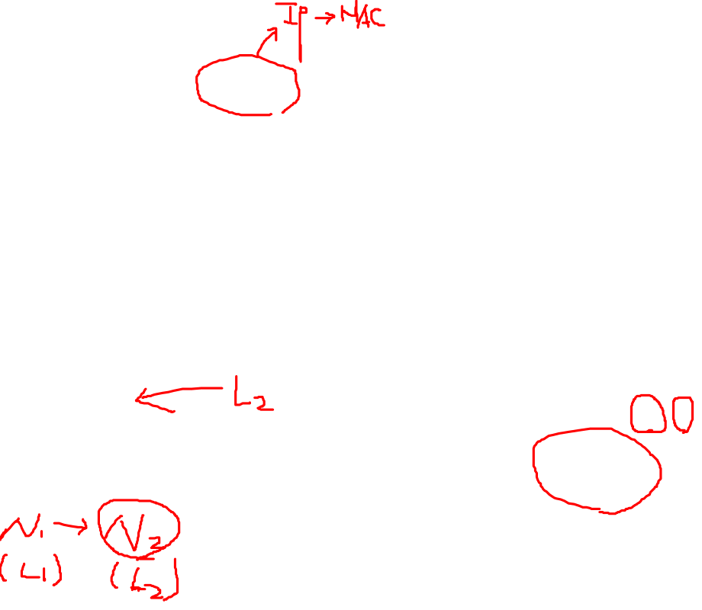
Figure 9.7: ARP operation

Slide 7
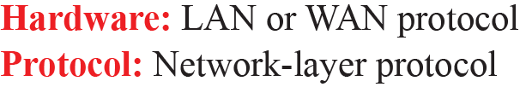
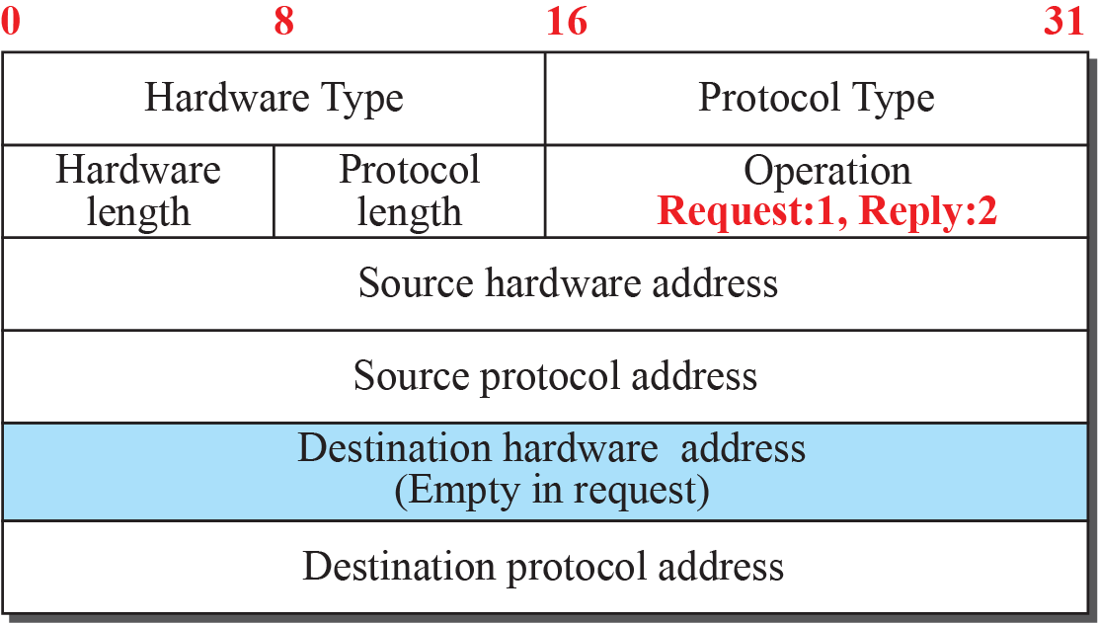
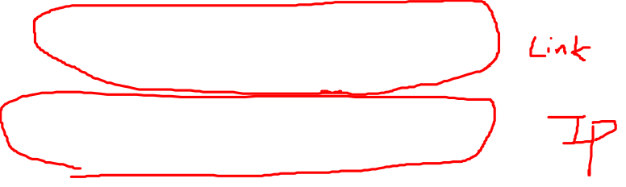
Figure 9.8: ARP packet

